Slide 1
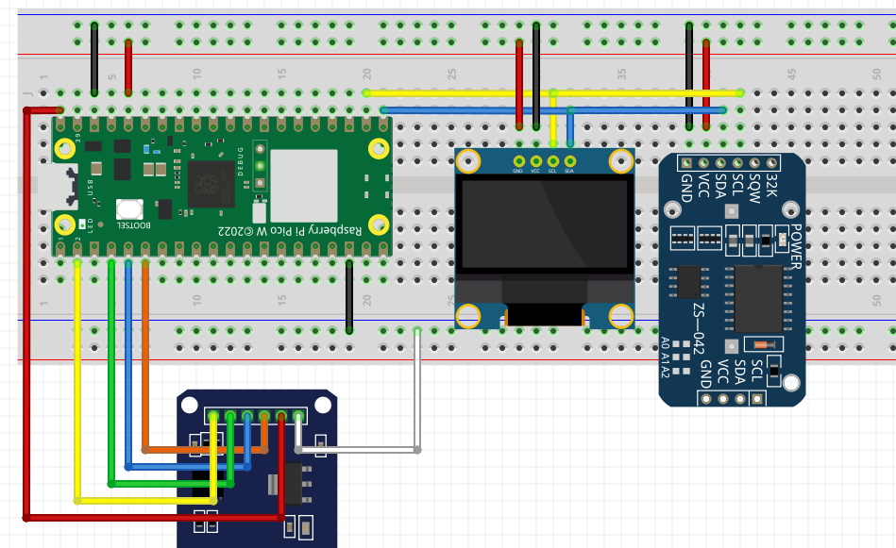


DATE TIME AND DATA LOGGING PRESENTATION
SD Card Writer
DS3231 RTC

Slide 2
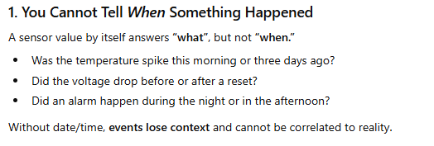
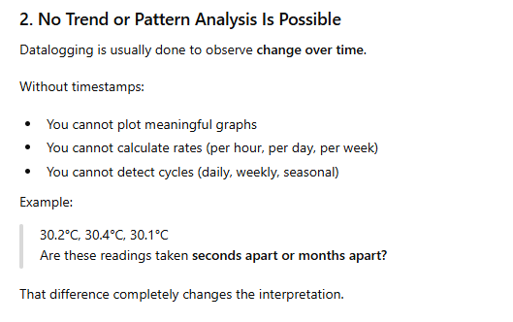
The case for datalogging
Data without date time stamp is useless

Slide 3
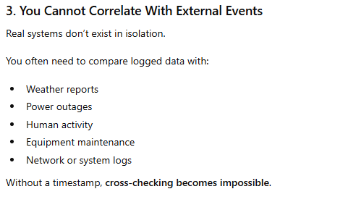
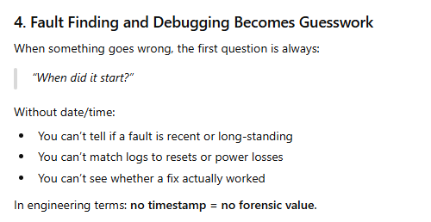

Slide 4
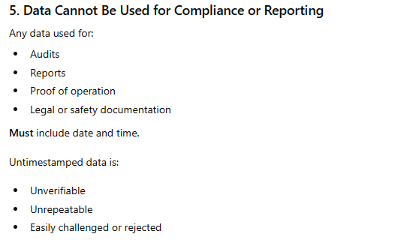
Storage Without Time Is Just Numbers in a File
At that point, you don’t really have data—you have detached values.
In practice:
Timestamp + value = information
Value alone = noise

Slide 5
In our previous example we learn how to:
Get Date – time information
Get Pico’s internal temperature
We now want these information data-logged for future reference
We can save the date/time information with the temperature values:
In Pico’s internal memory
In a SD Card
Cloud services such as Thingspeak
DB system such as InfluxDB
Problem with getting accurate Date/Time
Challenges in the field :
Source for Accurate Date/Time
Availability of Wi-fi/Internet

Slide 6
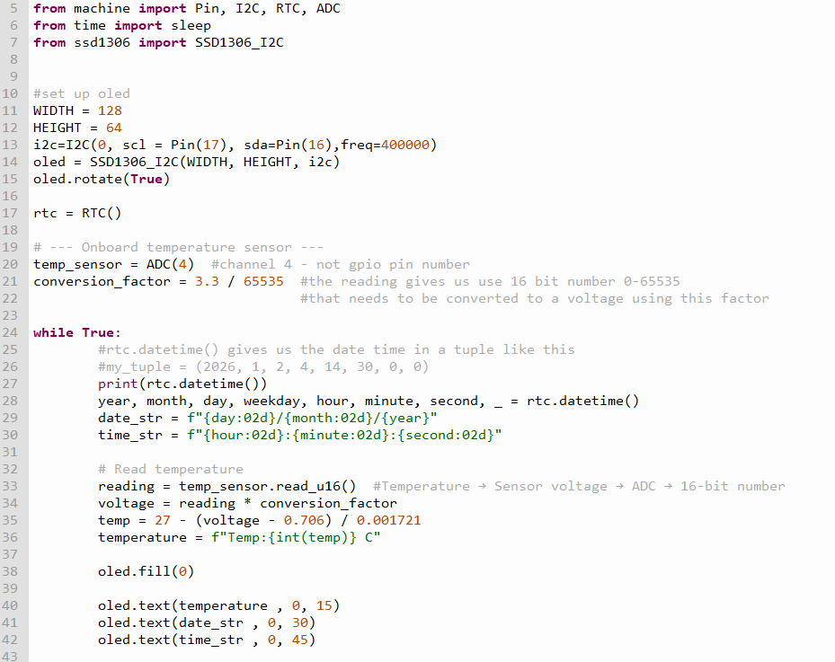
Example_1.py
#connected to laptop
#no DS3231 real time clock module
#date time comes from the laptop

Slide 7
Save the program as main.py
Unplug from laptop’s usb
Run from power bank
The date / time is now some unknown value
If you have wifi and internet connection, you can still get the correct
date time for the Pico W
- Using NTP

Slide 8
What is NTP?
What NTP is
NTP = Network Time Protocol
It is a protocol used to get the accurate current time from servers on the internet.
It gives UTC time (Coordinated Universal Time)
Very accurate — usually within a few milliseconds to a second
Think of it as asking a “time server”:
“Hey, what time is it right now in UTC?”

Slide 9
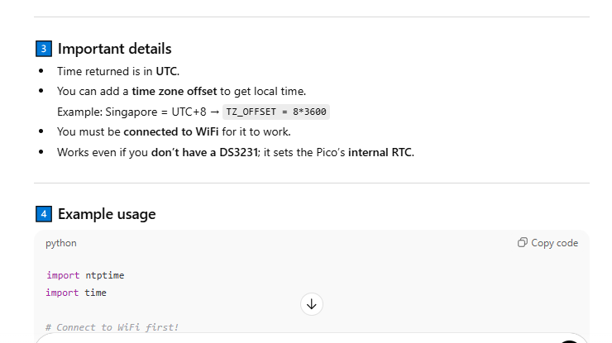
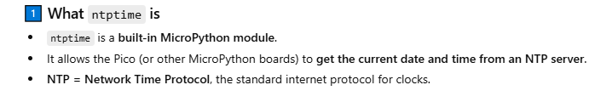
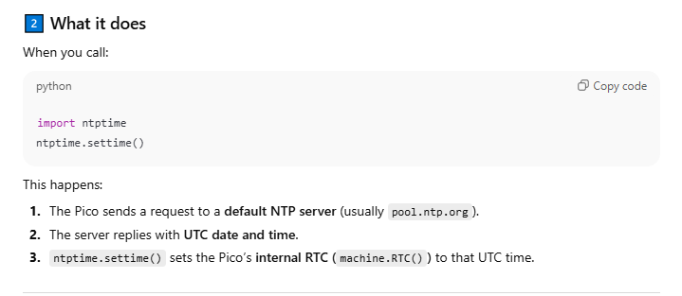

Slide 10
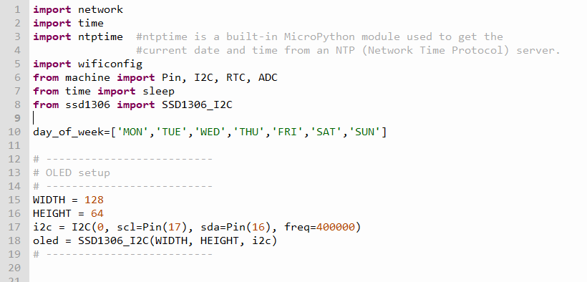
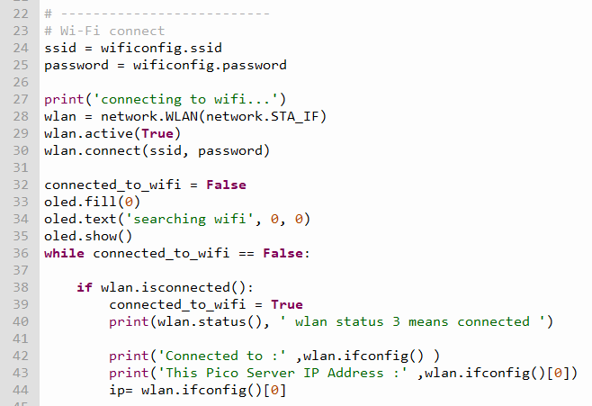
Example_2.py
#NOT connected to laptop
#no DS3231 real time clock module
#date time comes from the Internet

Slide 11
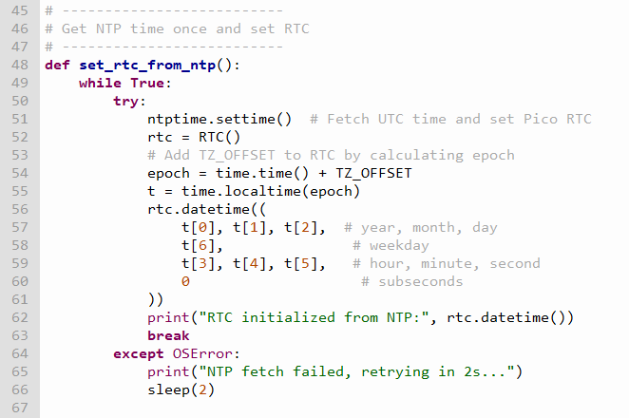

Slide 12
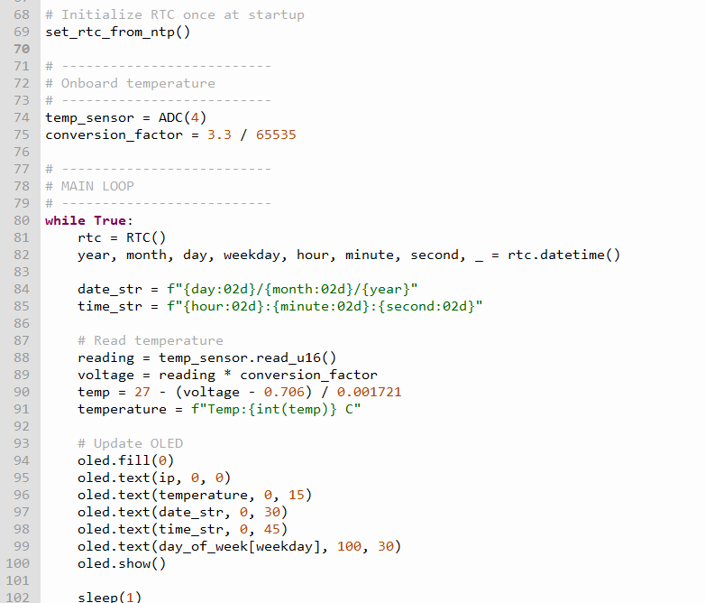
This module converts the
Data we get from the ntpserver
Into human readable data
(2026,1,3,5,9,6,2,0)
year,month,day,weekday,hour,minute,second,subsecond)

Slide 13
Example_3.py and setting_ds3231.py

Slide 14
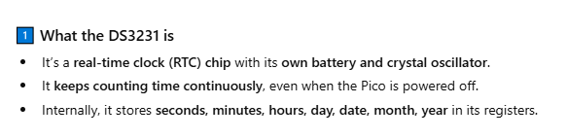
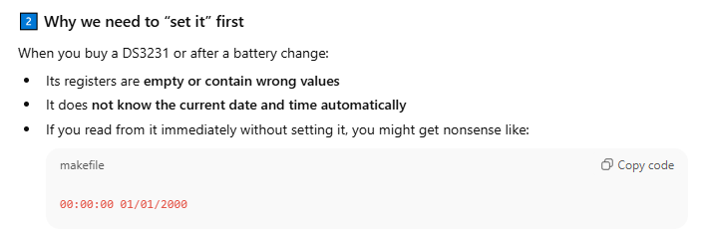
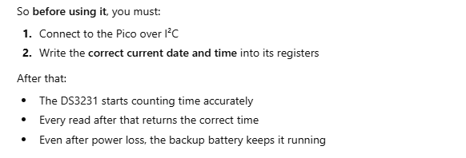
setting_ds3231.py – set the date time clock on the ds3231 Real Time Clock

Slide 15
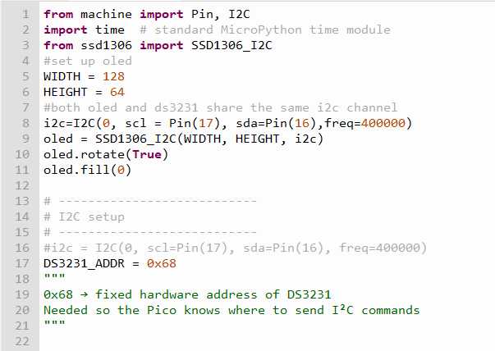
Setting_ds3231.py – sets the current time of the ds3231 RTC

Slide 16
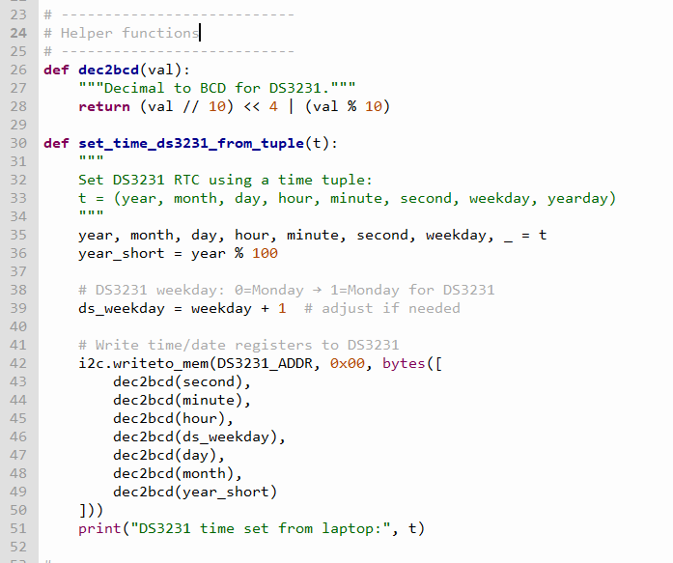

Slide 17
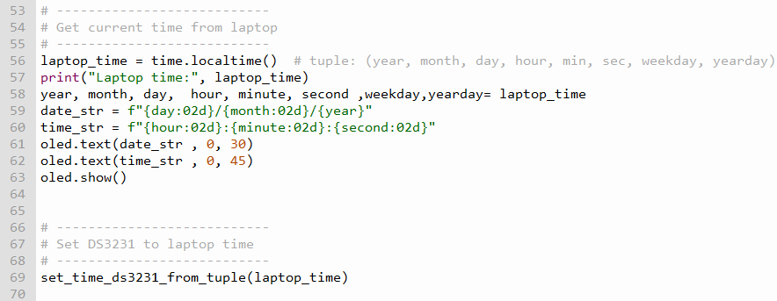
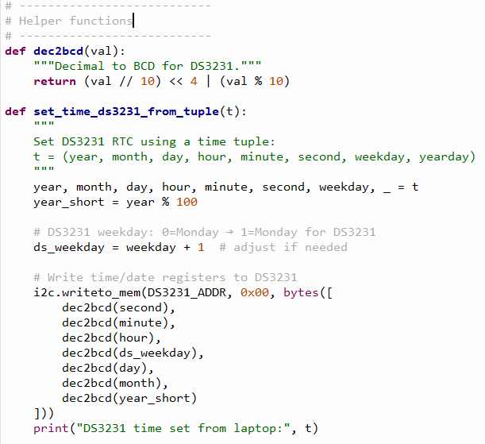
Once the current time is set, the ds3231 RTC will continue
To update itself with the current date/time like our watch.
A pico connected to it will get the RTC from it

Slide 18
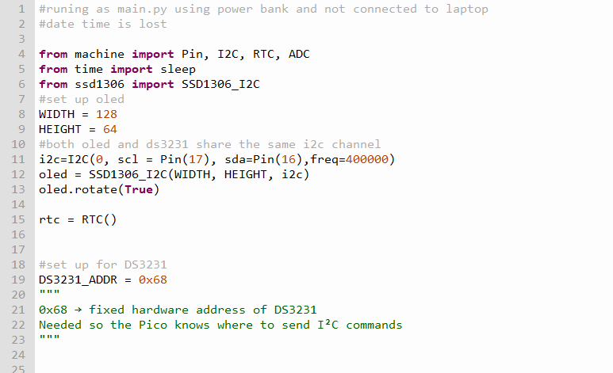
Example_3.py – Using the ds3231 with date that is already set.

Slide 19
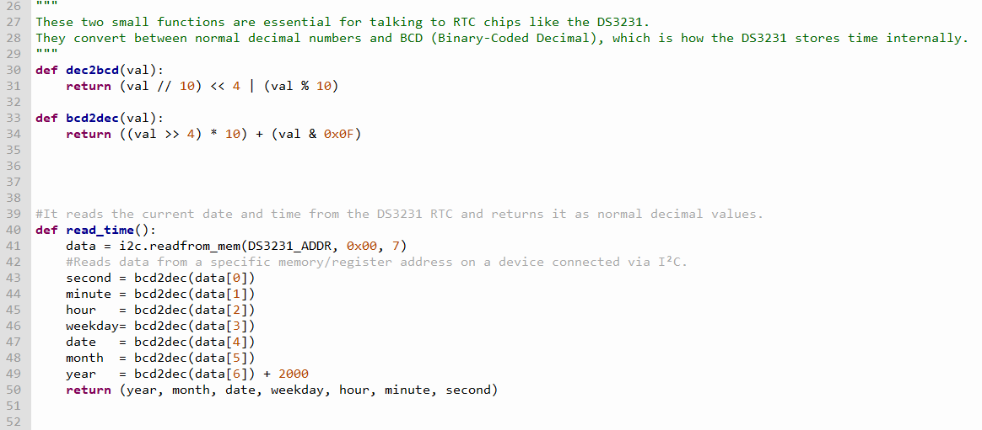
Then converted to human readable form
By these functions

Slide 20
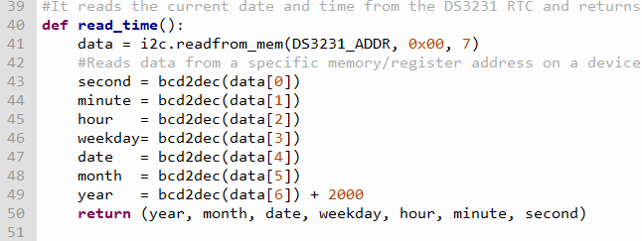
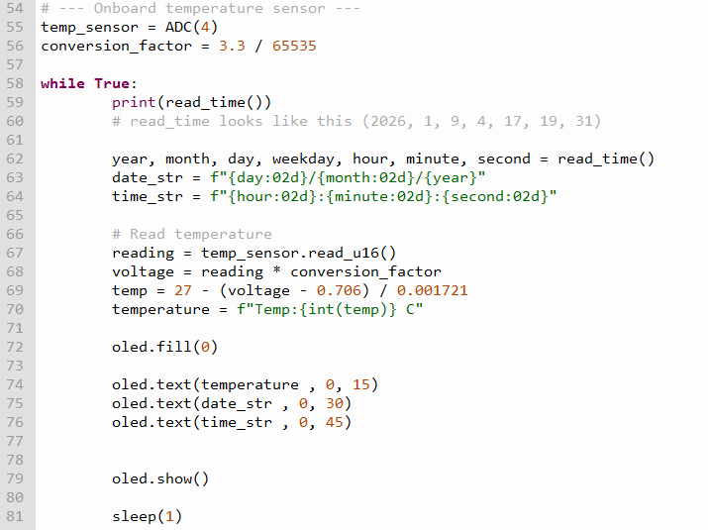
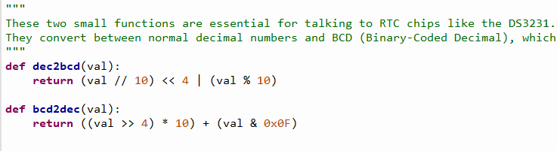
Then converted to human readable form
By these functions

Slide 21
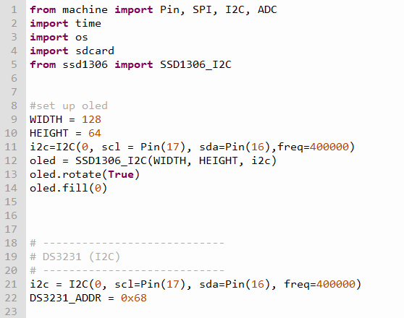
sd_card_demo.py
ssd1306 oled and ds3231
using the same i2c channel
ds3231 address = 0x68
We do not have to set date on the ds3231
Because we have set it earlier using
setting_ds3231.py

Slide 22
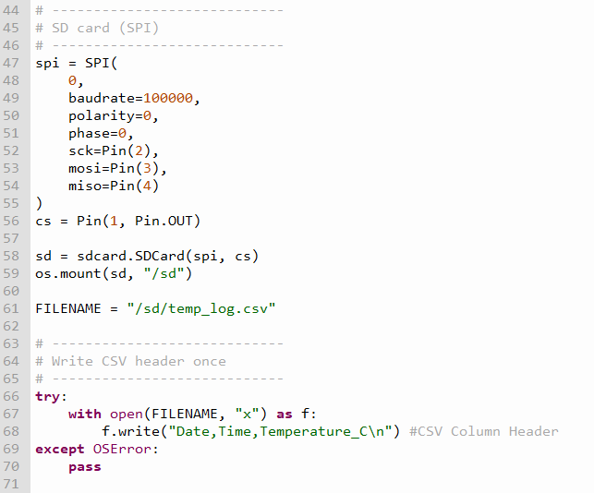
Set up for SD Card Reader
It uses SPI comms
We want our program to create a csv file.
It has to be preceded with /sd/
“x” means we want to file to be created exclusively
If it is present, do not over-write it
f.write(“Date,Time,Temperature”)
Are column headers

Slide 23
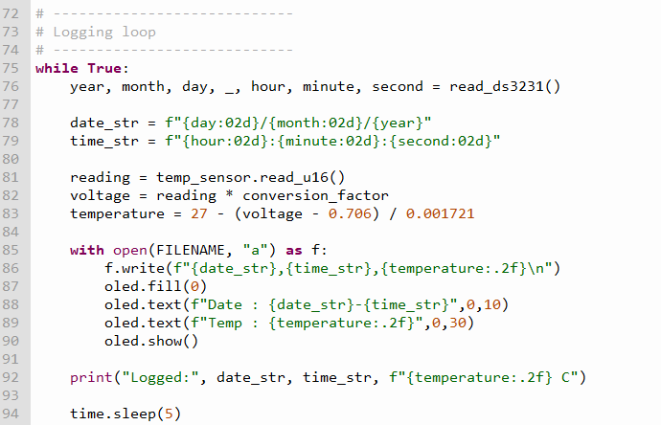
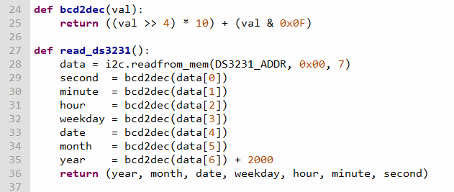
To human readable form

